Slide 1
METRO NEW JERSEY CHAPTER OF THE APPRAISAL INSTITUTE
81st Annual Princeton Conference – April 28, 2017
“Pipeline Easements and Issues”
Victor D. DiSanto, MAI - Moderator
Sterling, DiSanto & Associates
Michael J. Ash, Esq.
DeCotiis, Fitzpatrick, Cole & Giblin, LLP
Anthony F. DellaPelle, Esq., CRE
McKirdy & Riskin, PA
Maurice Stack, MAI, CRE, FRICS
Stack, Coolahan & Stack

Slide 2

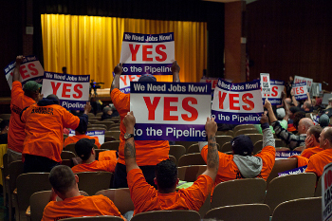
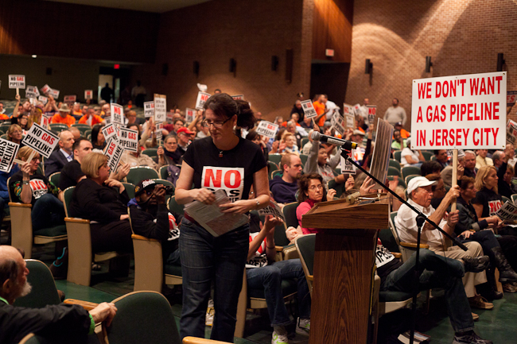
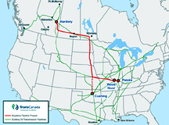
HISTORY
Public utilities are required infrastructure
Older developed areas require upgrades/expansion
Newer developing areas need services
Local agencies can be condemnors AND condemnees
HOT ISSUES
1. Keystone Pipeline
Wind Farms
Solar Farms
Gas Pipelines
Water Rights

Slide 3
Public Utilities and the Eminent Domain Power
Public Utilities can exercise eminent domain
Statutory Grant
  Natural Gas Act (NGA), 15 U.S.C. 717F(h)
  New Jersey -- N.J.S.A. 48:3-17.7
  Local authorities normally created
  by state legislation
Requires Administrative/Regulatory Approval
Limited Authority
Prior Public Use Doctrine

Slide 4
Public Utilities and Eminent Domain Power
Public Utilities can exercise eminent domain
Statutory Grant
Requires Administrative/Regulatory Approval
  Application for certificates shall be made in writing to the Commission, be verified under oath, and shall be in such form, contain such information, and notice thereof shall be served upon such interested parties and in such manner as the Commission shall, by regulation, require. Natural Gas Act (NGA), 15 U.S.C. 717F(h)
  The power of condemnation shall not be used or enforced by any such public utility . . . [e]xcept where a governmental agency having jurisdiction has granted the utility the permission to take or acquire property or any interests for the utility's purposes the power of condemnation shall not be used or enforced by any public utility until and unless such utility shall have applied to the Board of Public Utility Commissioners. . . . N.J.S.A. 48:3-17.7.
Limited Authority
Prior Public Use Doctrine

Slide 5

Public Utilities and Eminent Domain Power
Public Utilities can exercise eminent domain
Statutory Grant
Requires Administrative/Regulatory Approval
Limited Authority
  Limited to designated area and properties.
  Subject to restrictions imposed by statute and/or regulation
    Must compensation precede the taking?
    Is preliminary entry authorized?
  Consideration of jurisdictional issues for regional, interstate and international projects
Prior Public Use Doctrine

Slide 6

Public Utilities and Eminent Domain Power
Public Utilities can exercise eminent domain
Statutory Grant
Requires Administrative/Regulatory Approval
Limited Authority
Prior Public Use Doctrine
  The general rule is that a private company that has been authorized to exercise general eminent domain powers cannot do so on land that has already been devoted to public use. State Highway Commission v. Hoester, 362 S.W. 2d 519 (Mo. 1962)
  See U.S. v. Carmack, 329 U.S. 230 (1946), which contains dictum suggesting that eminent domain authority delegated to private entities (such as utility companies) is limited and therefore subject to a more stringent standard of review than similar delegations to governmental actors.
  Examples and exceptions :
    Will a balancing test be used? See Texas Eastern v. Wildlife Preserves, Inc., 225 A. 2d 130 (N.J. 1966)
    Water company’s rights not exclusive. City of Raton v. Raton Ice Co. 191 P. 518 (N.M. 1920)

Slide 7
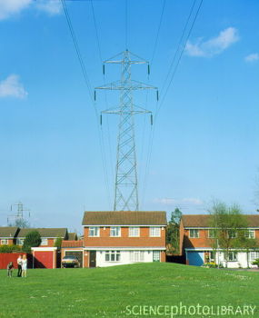
Public Utilities and Eminent Domain Power
Choice of Forum
Federal Law and Court – Penn East
  Federal Statute authorizing project and condemnation
  Regulatory process through FERC
  Federal court and jurisdiction
  Disclosure requirements
  Litigation process – no jury trial and different procedures
State Law and Court – South Jersey Gas
  State statutes authorizing project and condemnation
  Regulatory process through BPU
  State court and procedures
  Safeguards to property owners through Eminent Domain Act

Slide 8
Public Utilities and Eminent Domain Power
Federal Law and Court – Penn East
  Federal Statute authorizing project and condemnation
    Natural Gas Act (NGA), 15 U.S.C. 717f(c)– authorizes the “construction or extension of facilities…for the transportation of in interstate commerce of natural gas
    Pipeline company must demonstrate actual need for project through contracts with shippers and customers
    Must receive Certificate of Public Convenience and Necessity from the Federal Energy Regulatory Commission (FERC)
    15 U.S.C. 717F(h) – provides authorization for acquisition of property by condemnation
  Regulatory process through FERC
  Federal court and jurisdiction
  Disclosure requirements
  Litigation process – no jury trial and different procedures

Slide 9
Public Utilities and Eminent Domain Power
Federal Law and Court – Penn East
  Federal Statute authorizing project and condemnation
  Regulatory process through FERC
    Pre-Filing – public informational hearings with public comment and input from property owners and government stakeholders
    Environmental Review – NEPA/EIS - due diligence including: route studies; field surveys; wetlands delineations and alternatives/benefits analysis
    FERC Certificate – approves a 50 foot Right-of-Way and facilities for project, authorizes condemnation, includes conditions on construction
    Post-Certificate Proceedings – Application for FERC re-hearing in federal court
  Federal court and jurisdiction
  Disclosure requirements
  Litigation process – no jury trial and different procedures

Slide 10
Public Utilities and Eminent Domain Power
Federal Law and Court – Penn East
  Federal Statute authorizing project and condemnation
  Regulatory process through FERC
  Federal court and jurisdiction
    Condemnation in Federal Court – US District Court of NJ
    FERC Certificate Pre-Empts State and local regulations including zoning
    Construction and Operation in accordance with Pipeline and Hazardous Materials Safety Administration
  Disclosure requirements
  Litigation process – no jury trial and different procedures

Slide 11
Public Utilities and Eminent Domain Power
Federal Law and Court – Penn East
  Federal Statute authorizing project and condemnation
  Regulatory process through FERC
  Federal court and jurisdiction
  Disclosure requirements
    Offer letter required – no duty to negotiate in good faith in most jurisdictions including NJ
      No requirement for appraisal
      No minimum of 14 days for negotiations
      No survey required
    Public Purpose if Property is Within FERC Certificated route
  Litigation process – no jury trial and different procedures

Slide 12
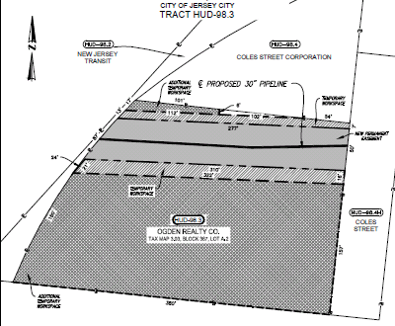


Slide 13
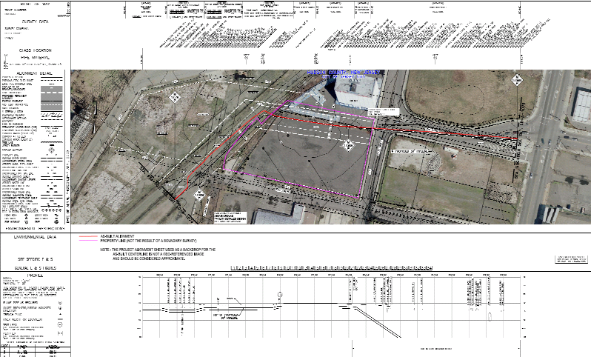
Tract HUD 98.3

Slide 14
Public Utilities and Eminent Domain Power
Federal Law and Court – Penn East
  Federal Statute authorizing project and condemnation
  Regulatory process through FERC
  Federal court and jurisdiction
  Disclosure requirements
  Litigation process – no jury trial and different procedures
    Notice of Condemnation , Complaint, and Order of Taking
    No “quick take” – motion for summary judgment or preliminary injunction depending on jurisdiction
    Valuation Litigation
      Burden of Proof is on Property Owner
      Jury trial, bench trial, or Commissioners’ Hearing
      Federal Substantive Law applies – Yellow Book

Slide 15
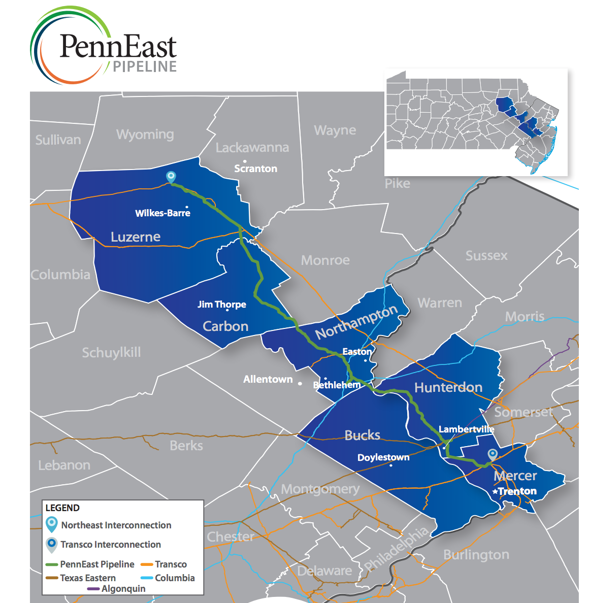
Penn East Pipeline
Status: Final
Environmental
Impact Statement
Approved by
FERC on 4/7/17

Slide 16
Public Utilities and Eminent Domain Power
State Law and Court – South Jersey Gas
  State statutes authorizing project and condemnation
    N.J.S.A. 48:3-17.6
  Regulatory process through BPU
  State court and procedures
  Safeguards to property owners through Eminent Domain Act

Slide 17
Public Utilities and Eminent Domain Power
State Law and Court – South Jersey Gas
  State statutes authorizing project and condemnation
  Regulatory process through BPU
    Regulated Utility files a Petition for acquisition of properties in furtherance of a new project
    BPU holds public hearings, accepts briefs, discovery, and hears testimony from the petitioner, the Board’s staff, and often the Division of Rate Counsel (N.J.A.C. 1:1-16.3)
    BPU or OAL makes a determination of necessity that an acquisition is “reasonably necessary”
  State court and procedures
  Safeguards to property owners through Eminent Domain Act

Slide 18
Public Utilities and Eminent Domain Power
State Law and Court – South Jersey Gas
  State statutes authorizing project and condemnation
  Regulatory process through BPU
    Regulated Utility files a Petition for acquisition of properties in furtherance of a new project
    BPU holds public hearings, accepts briefs, discovery, and hears testimony from the petitioner, the Board’s staff, and often the Division of Rate Counsel (N.J.A.C. 1:1-16.3)
    BPU or OAL makes a determination of necessity that an acquisition is “reasonably necessary”
  State court and procedures
  Safeguards to property owners through Eminent Domain Act

Slide 19
Public Utilities and Eminent Domain Power
State Law and Court – South Jersey Gas
  State statutes authorizing project and condemnation
  Regulatory process through BPU
  State court and procedures
    Acquisitions in accordance with Eminent Domain Act
    Good faith negotiations
        Property owner has right to accompany appraiser
        Must have appraisal report
        No “take it or leave it” offers
        At least 14 days of negotiations
    Complaint is filed in County where property is located
  Safeguards to property owners through Eminent Domain Act

Slide 20
Public Utilities and Eminent Domain Power
State Law and Court – South Jersey Gas
  State statutes authorizing project and condemnation
  Regulatory process through BPU
  State court and procedures
  Safeguards to property owners through Eminent Domain Act
    Good Faith Negotiations
    Limitations on Exercise of Eminent Domain by Private Corporations
      No statutory right to preliminary entry
      No statutory right to “quick take” – possession only after deposit of Commissioners’ award
    Right to jury trial on just compensation

Slide 21
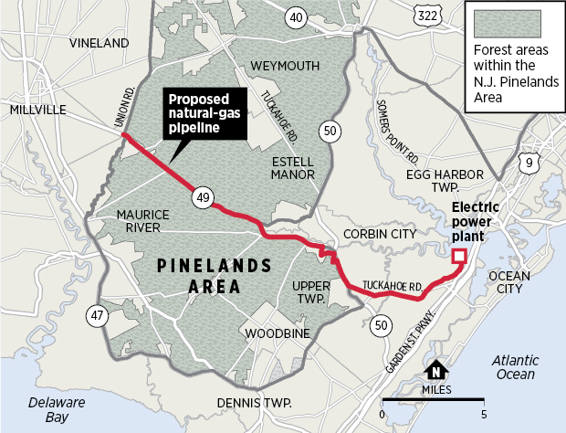
South Jersey Gas Pipeline
Status: Approved
By BPU and
Pinelands
Commission;
Under challenge
By Sierra Club

Slide 22
Public Utilities and Eminent Domain Power
Valuation Issues
Partial Takings
  Value of property actually acquired.
  Easements and the “bundle of rights”
  Difference between property value “before and after “taking.
  Route selection and location of taking within remainder of properties can be critical
  Just compensation vs. public relations
  Question: Is a property with a sewer or gas connection more valuable, or does the easement burden devalue the property? Consider project influence implications.
View
Fear

Slide 23
Public Utilities and Eminent Domain Power
Valuation Issues
Partial Takings
View
  Requires at least partial taking - PSE & G v. Oldwick Farms, 308 A. 2d 362 (N.J. App. Div. 1973).
  Compare loss of view vs. loss of visibility. Keinz v. State, 156 N.Y.S. 2d 505 (N.U. 1956)(damages may be awarded when owner’s view out from property has been impaired but not when visibility into property is diminished)
Fear

Slide 24

Public Utilities and Eminent Domain Power
Valuation Issues
Partial Takings
View
Fear
  Appeal of Giesler, 622 A. 2d 408 (Pa. 1993)(despite lack of scientific evidence that electric lines may create health risk , public perception is relevant in determining damages)
  Criscuola v. Power Auth. 621 N.E. 2d 1195 (N.Y. 1993)(public fear and subjective believes of buyers regarding power lines is irrelevant unless objective market evidence exists )

Slide 25
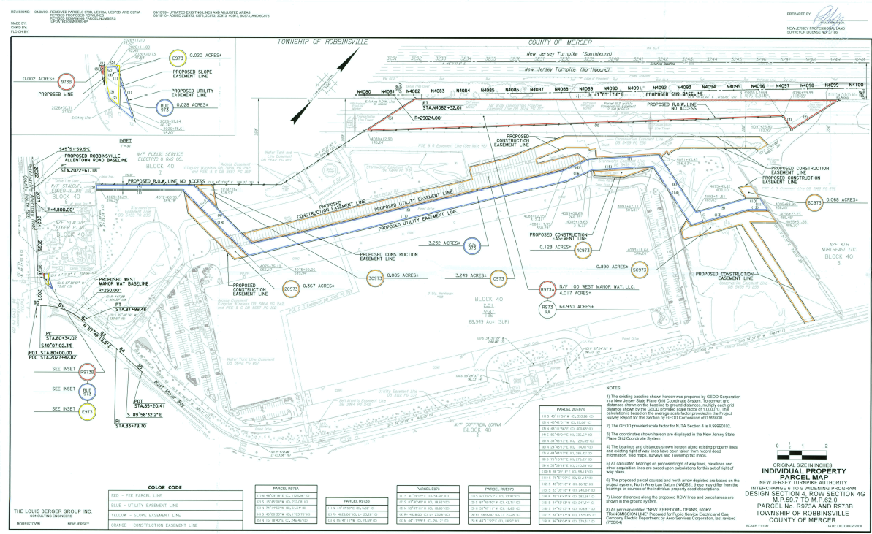
NJTA v. 100 West Manor Way

Slide 26
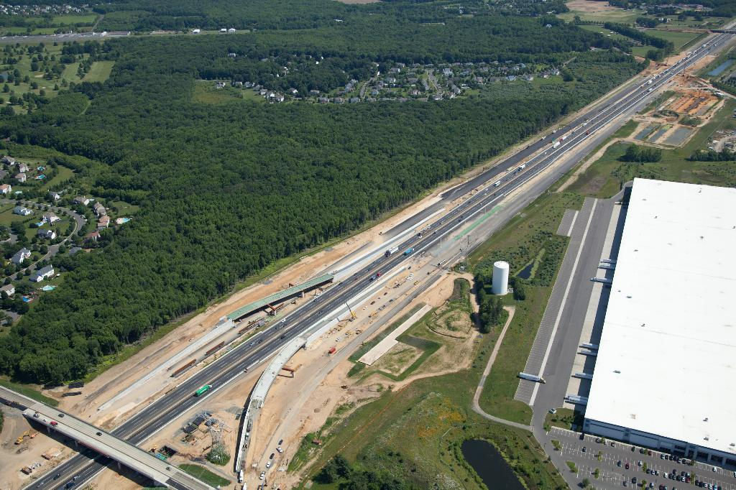
NJTA v. 100 West Manor Way

Slide 27
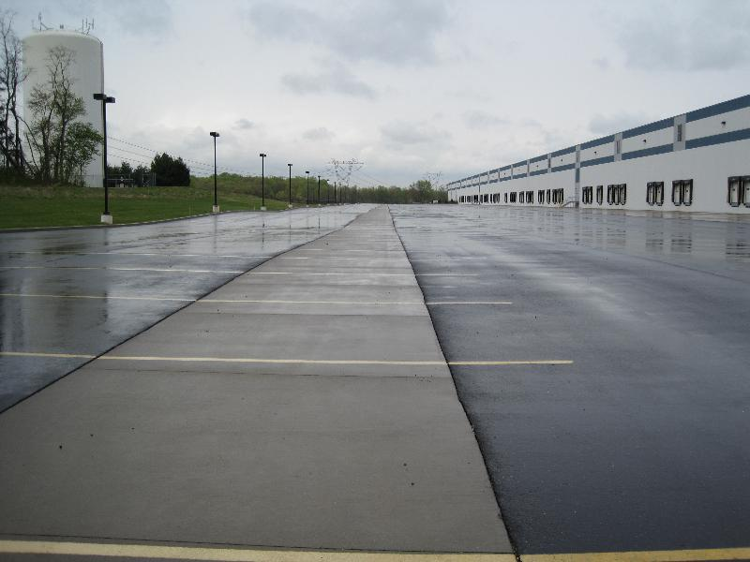
NJTA v. 100 West Manor Way

Slide 28

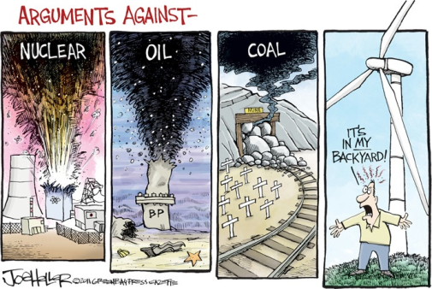

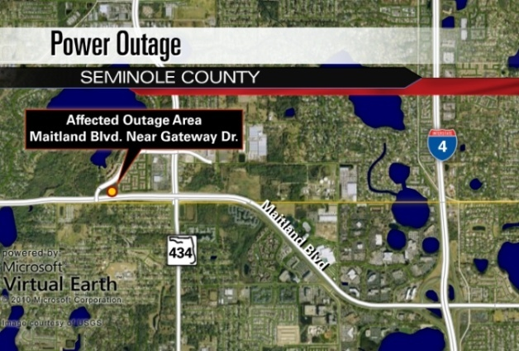
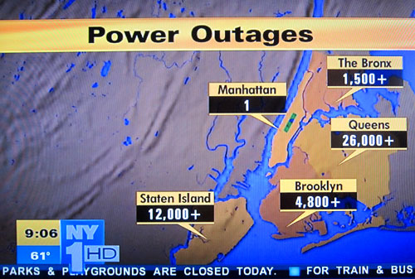

Nobody wants them:
But everyone is unhappy when:

