Slide 1

Hackensack Main Street Redevelopment: Have the Rules of the Game Changed?
A Webinar
New Jersey Institute for Continuing Legal Education
August 11, 2015

Slide 2


The Panel
Anne S. Babineau, Esq. , CRE
ababineau@wilentz.com
www.wilentz.com
Partner: Wilentz, Goldman & Spitzer, PA
Chair of Firm Redevelopment Practice
Member, Counselors of Real Estate®
Member, American College of Real Estate Lawyers
Program Chair – NJICLE Annual Redevelopment Institute
Counsel to developers and redevelopment agencies in municipalities such as Jersey City, New Brunswick, Hoboken, Belmar, Collingswood, Montclair, Camden, Elizabeth and Pennsauken
Experience in Brownfields redevelopment projects in cities such as Newark, Linden, Carteret, Perth Amboy and Trenton
Experience in redevelopment designations, redevelopment plans and agreements, incentive programs, abatement and financing agreements and related litigation
Officer and member of industry organizations such as New Jersey Future, NAIOP and Urban Land Institute
New Jersey “Super Lawyer”; Best Lawyers in America; Chambers USA
Member, NJ Builders’ Association Land Use and Redevelopment Committee

Slide 3


The Panel
Anthony F. Della Pelle, Esq. , CRE
adellapelle@mckirdyriskin.com
www.mckirdyriskin.com
Practice limited to eminent domain, condemnation, redevelopment and real estate tax appeals
25+ years representing property owners and special counsel to condemning authorities in eminent domain matters
Author, New Jersey Condemnation Law Blog, www.njcondemnationlaw.com
New Jersey “Super Lawyer” (“Top 100” - 2009-2015; “Top 10” – 2012)
Subcommittee Chair, ABA Section of Litigation – Condemnation, Land Use & Zoning Committee
Member of Governor Chris Christie’s Transition Team – Authorities Committee (2009)
Member, NJ Builders’ Association Land Use and Redevelopment Committee
Shareholder, McKirdy & Riskin, PA
Certified Civil Trial Attorney by NJ Supreme Court
New Jersey Representative, Owners’ Counsel of America
Member, Counselors of Real Estate®

Slide 4
Redevelopment Basics in NJ
Constitutional Provisions
Article 8, § 3, ¶ 1: The clearance, replanning, development or redevelopment of blighted areas shall be a public purpose and public use, for which private property may be taken or acquired.
Municipal, public or private corporations may be authorized by law to undertake such clearance, replanning, development or redevelopment; and improvements made for these purposes and uses, or for any of them, may be exempted from taxation, in whole or in part, for a limited period of time during which the profits of and dividends payable by any private corporation enjoying such tax exemption shall be limited by law…
Legislation: Local Redevelopment and Housing Law, N.J.S.A. 40A:12A-1 et seq.
Notes:
4

Slide 5
How It Works
An area can be:
“In need of redevelopment” or,
“In need of rehabilitation”
A determination that an area is “in need of rehabilitation” does not authorize involuntary takings, and limits the financial incentives to shorter term abatements and programs
Notes:
Criteria for rehabilitation:
Structures are deteriorated
Pattern of vacancy
Persistent tax arrearages.

Slide 6
How It Works
If an area is “in need of redevelopment” then:
Government can take the land.
Government can make deals with redevelopers.
Redevelopers can assemble and can qualify for tax abatements.

Slide 7
Procedure – Direction to Investigate
Governing Body → Planning Board
The governing body, by resolution, authorizes the planning board to investigate whether a proposed area is a redevelopment area.
N.J.S.A. 40A:12A-6(a)
Notes:
N.J.S.A. 40A:12A-6(a)

Slide 8
Procedure - Notice
Planning board sets date for public hearing
Notice by publication – twice - with last publication not less than 10 days in advance of the hearing.
Individualized notice by mail to last known owner as reflected on assessment
N.J.S.A. 40A:12A-6(b)(2) and (3)
Notes:
N.J.S.A. 40A:12A-6(b)(2) and (3)
There is also a procedure whereby one with an interest in property can register with the municipality to receive notices.

Slide 9
Procedure - Hearing
The planning board conducts a public hearing at which time all interested persons may be heard.
The hearing record is the basic record for for purposes of judicial review.
N.J.S.A. 40A:12A-6(b)(4)

Slide 10
Procedure - Recommendation
Planning Board → Governing Body
Following the hearing, the planning board recommends to governing body whether the proposed redevelopment area, or any part thereof, constitutes a redevelopment area under the statutory criteria.
N.J.S.A. 40A:12A-6(b)(5)

Slide 11
Procedure - Determination
After receiving the recommendation from the planning board, the governing body, by resolution, may determine that the proposed redevelopment area, or any part thereof, constitutes an “area in need of redevelopment.”
N.J.S.A.40A:12B-6(b)(5)

Slide 12
The Redevelopment Plan
Adopted by Ordinance.
No evidential hearings – regular ordinance procedures followed.
Sets up new zone, or overlay zoning, for Area.
Identifies properties to be acquired
Provides for relocation
Must be consistent with Master Plan or passed by a majority with reasons for inconsistencies.
N.J.S.A.40A:12A-7

Slide 13
Upon adoption of Redevelopment Plan:
Involuntary acquisitions are authorized
New infrastructure can be installed
Contracts with redevelopers are authorized
Relocation assistance authorized
Other related powers
N.J.S.A.40A:12A-7

Slide 14
Agreements with Redevelopers
Public bidding not required.
Must contain covenant that only uses in Redevelopment Plan will be constructed.
Must contain deadlines for commencement of construction.
Must restrict resale of project prior to completion without municipal consent
Notes:
N.J.S.A.40A:12A-9

Slide 15
The Redevelopment Criteria N.J.S.A. 40A:12A-5
A delineated area may be determined to be “in need of redevelopment” if, any of the following conditions is found:
  The generality of buildings are substandard, unsafe, unsanitary, dilapidated, or obsolescent, or possess any of such characteristics, or are so lacking in light, air, or space, as to be conducive to unwholesome living or working conditions;
  The discontinuance of the use of buildings previously used for commercial, manufacturing, or industrial purposes; the abandonment of such buildings; or the same being allowed to fall into so great a state of disrepair as to be untenantable;
  Land that is owned by the municipality, …or unimproved vacant land that has remained so for a period of ten years prior to adoption of the resolution, and that by reason of its location, remoteness, lack of means of access to developed sections or portions of the municipality, or topography, or nature of the soil, is not likely to be developed through the instrumentality of private capital;
Notes:
N.J.S.A. 40A:12A-5. Conditions within delineated area establishing need for redevelopment.
You only need one criteria.

Slide 16
The Redevelopment Criteria N.J.S.A. 40A:12A-5
  Areas with buildings or improvements which, by reason of dilapidation, obsolescence, overcrowding, faulty arrangement or design, lack of ventilation, light and sanitary facilities, excessive land coverage, deleterious land use or obsolete layout,…are detrimental to the safety, health, morals, or welfare of the community
*A growing lack or total lack of proper utilization of areas caused by the condition of the title, diverse ownership of the real [property] properties therein or other similar conditions which impede land assemblage or discourage the undertaking of improvements, resulting in a stagnant [or] and [not fully productive] unproductive condition of land potentially useful and valuable for contributing to and serving the public health, safety and welfare, which condition is presumed to be having a negative social or economic impact or otherwise being detrimental to the safety, health, morals, or welfare of the surrounding area or the community in general;
Areas, in excess of five contiguous acres, whereon buildings or improvements have been destroyed, consumed by fire, demolished or altered by the action of storm, fire, cyclone, tornado, earthquake or other casualty….

Slide 17
Important Redevelopment Case Law
Berman v. Parker, 348 U.S. 26 (1954)
1. Clearing blight is a public purpose
2. Determining how blight should be cleared is left to the legislature
3. Cases will not be decided on a piecemeal basis
Kelo v. City of New London, 545 U.S. 469 (2005)
1. Fifth Amendment is satisfied is scope of plan serves a public purpose
2. “Public purpose” is defined broadly
3. Revitalizing a distressed area to increase jobs and tax ratables is a public purpose

Slide 18
Important N.J.Redevelopment Case Law
Gallenthin Realty v. Paulsboro, 191 N.J. 344 (2007)
67 acre vacant tract of land across Delaware River from Philadelphia Airport
Involved NJSA 40A:12A-5 (e)
Mere underutilization of a property will not satisfy the definition of blight under the Local Redevelopment and Housing Law (LRHL)
Blight must be based on the common sense understanding of the term

Slide 19
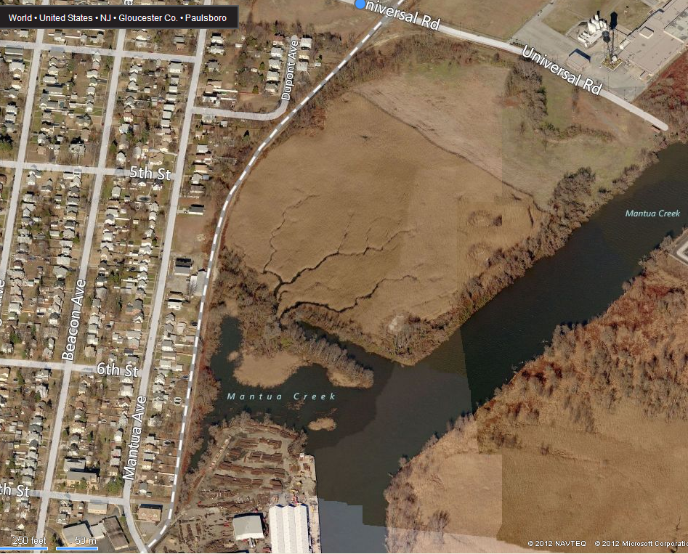
The Gallenthin property

Slide 20
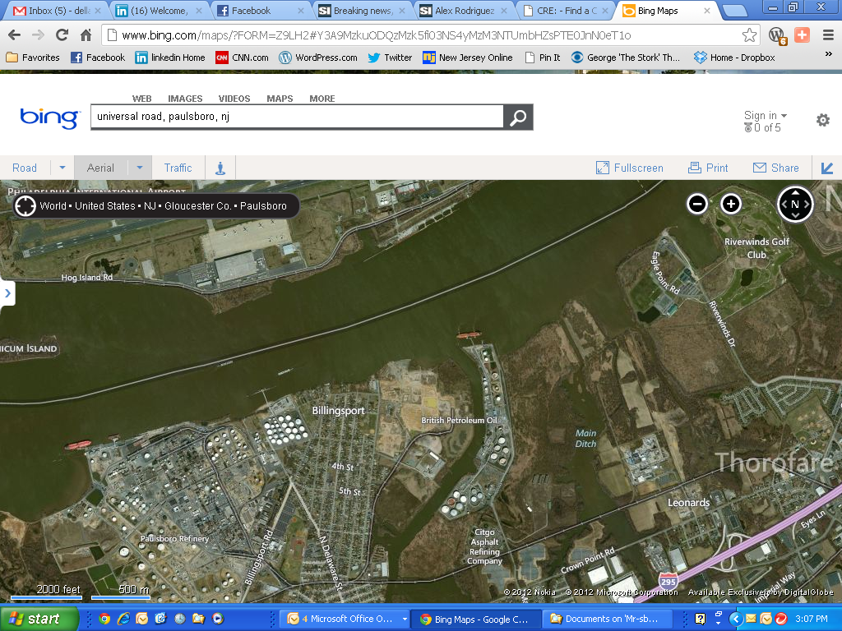
The Gallenthin property

Slide 21
Important N.J.Redevelopment Case Law
Harrison Redevelopment Agency v. DeRose, 398 N.J. Super. 361 (App. Div. 2008)
Notice of redevelopment proceedings must include:
1. A clear statement that a redevelopment plan gives the condemnor the right to take property by eminent domain.
2. A clear statement that the property is being targeted for redevelopment.
3. Any time limitations that may apply to the property owner to take legal action challenging a redevelopment plan.

Slide 22
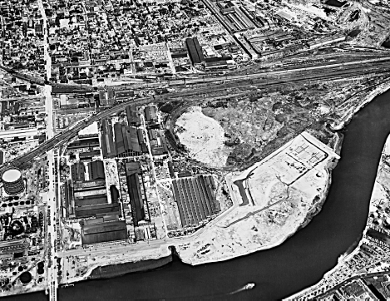
Harrison: C. 1960

Slide 23
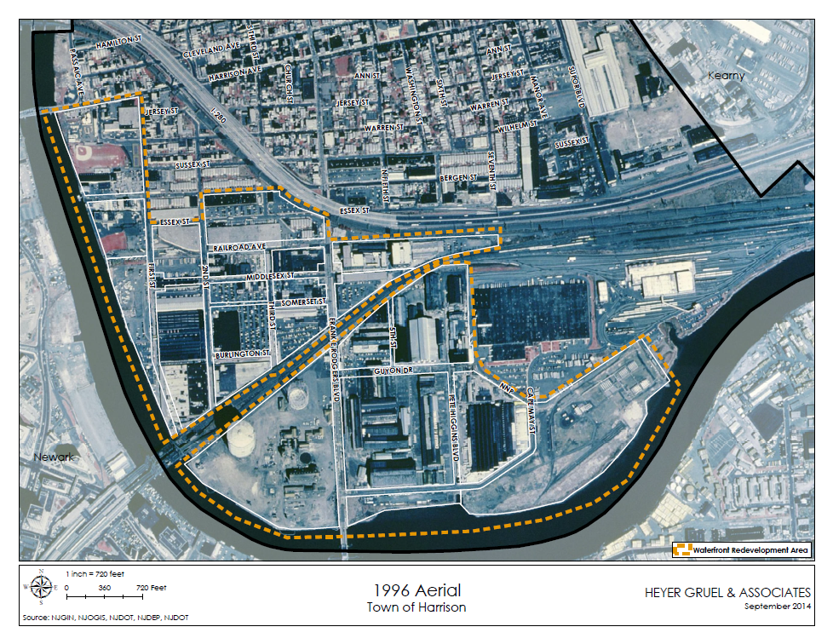
Harrison: 1996

Slide 24
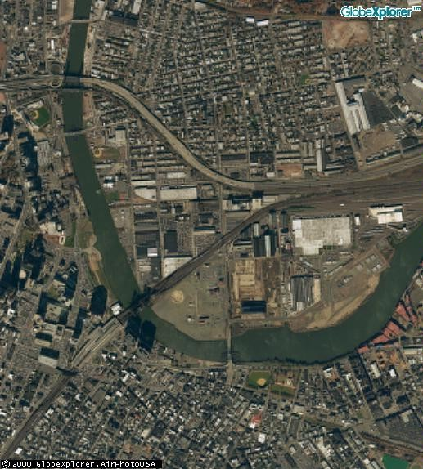
Harrison: C. 2000

Slide 25
Harrison: The Project’s Historical Perspective
Mid 1990s – redevelopment study and determination
2000 – first redevelopment plan and redevelopers
Preliminary challenges to project are rejected as untimely
9/11/01
2005-2006 renewed redevelopment efforts near station
  Acquisitions of Guyon Pipe and commuter parking lots
  Renewed challenges: takings filed in mid-2006
  Construction commences during appeal
Red Bull Stadium construction
Harrison v. DeRose, et als, decided 2/25/08
  Stay issued 3/2008
  Settlement reached 9/2008
    Environmental arbitration concludes 2/2010
    Valuation arbitration concludes 3/2011
  October, 2008 financial market turmoil
Other acquisitions, voluntary and via eminent domain
2012 plan amendments

Slide 26
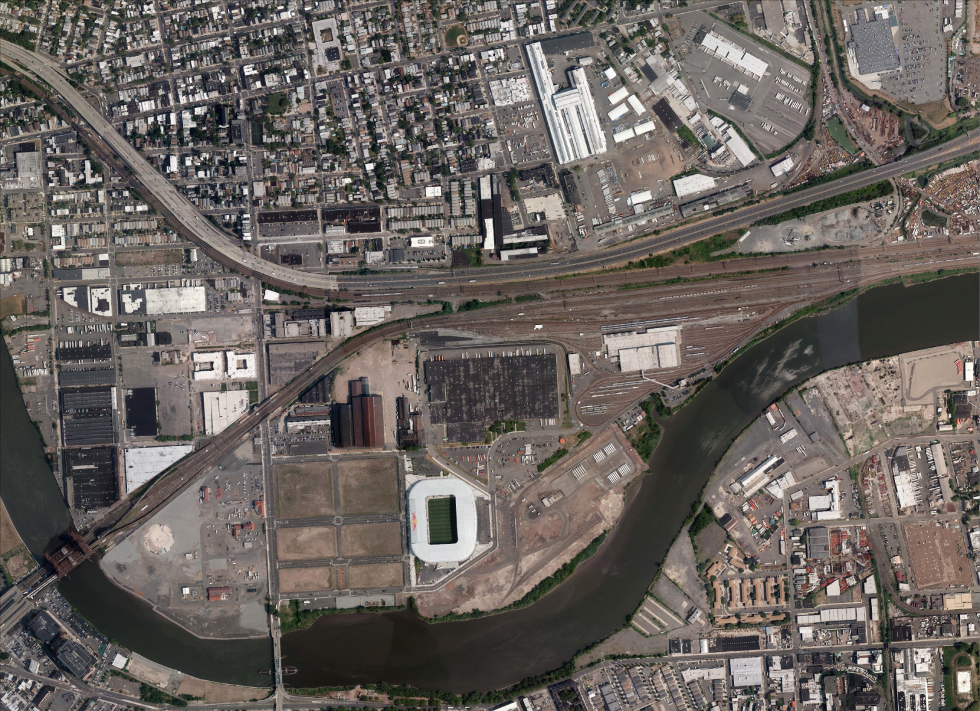
Harrison: 2012

Slide 27
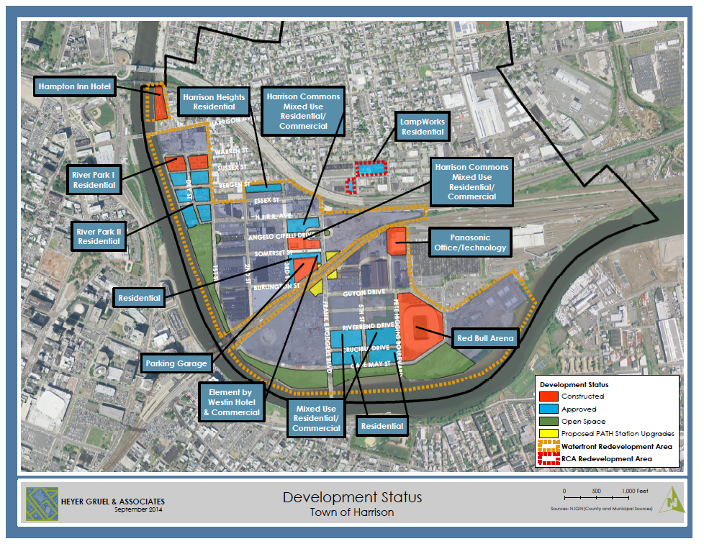
Harrison: 2014

Slide 28
Post-Kelo Reactions and Responses
More judicial scrutiny in redevelopment cases and other types of takings
Did redevelopment die in N.J. after Gallenthin and DeRose?
Prior failed legislative reform
A-3615/S-2447: a solution?
  Impact of Superstorm Sandy
  How the legislation came about
  Why redevelopment designation is important in the market

Slide 29
A3615/S2447 - Legislative Declarations
  “WHEREAS, Redevelopment remains a valid and important public purpose and the implementation of redevelopment programs continues to be a vital tool for municipal officials that must be maintained to allow them to continue to meet their governmental responsibilities to prevent, arrest, and reverse deleterious property conditions within their municipal borders;…
  “WHEREAS, Municipalities should be encouraged to engage in economic development initiatives by promoting and facilitating such efforts to create local economic stimulus and job creation through the tools and incentives available under the “Local Redevelopment and Housing Law;” and
  WHEREAS, Municipalities should be provided the opportunity to pursue such programs without the use of eminent domain…”
  N.J.S.A. 40A:12A-2

Slide 30
Legislative History of A-3615 / S-2447
Introduced in the Assembly on December 13, 2012 and in the Senate on January 8, 2013.
Passed by the Assembly 78-0-0 on May 20, 2013
Passed by the Senate 36-1 on June 20, 2013
Signed by Governor Christie on September 9, 2013 -- P.L.2013, c.159

Slide 31
Non Condemnation Redevelopment Area Resolution Requirement
The resolution authorizing the planning board to undertake a preliminary investigation shall state whether the redevelopment area determination shall authorize the municipality to use all those powers provided by the Legislature for use in a redevelopment area other than the use of eminent domain (hereinafter referred to as a "Non-Condemnation Redevelopment Area") or whether the redevelopment area determination shall authorize the municipality to use all those powers provided by the Legislature for use in a redevelopment area, including the power of eminent domain (hereinafter referred to as a "Condemnation Redevelopment Area")…..”
N.J.S.A. 40A:12A-6(a)

Slide 32
Non Condemnation Redevelopment Area Notice Requirement
  “…the notice of the hearing shall specifically state that a redevelopment area determination shall not authorize the municipality to exercise the power of eminent domain to acquire any property in the delineated area.”
  N.J.S.A. 40A:12A-6(b)(3)(b)

Slide 33
Changing Course To Permit Eminent Domain
The Non Condemnation Redevelopment Area is not necessarily permanent:
  “(g) If a municipal governing body has determined an area to be a Non-Condemnation Redevelopment Area and is unable to acquire property that is necessary for the redevelopment project, the municipality may initiate and follow the process set forth in this section to determine whether the area or property is a Condemnation Redevelopment Area. Such determination shall be based upon the then-existing conditions and not based upon the condition of the area or property at the time of the prior Non-Condemnation Redevelopment Area determination.”
  N.J.S.A. 40A:12A-6 (b) (5) (g)

Slide 34
Condemnation Redevelopment Area
Notice Requirement
  “(c) If the resolution assigning the investigation to the planning board, pursuant to subsection a. of this section, stated that the redevelopment determination shall establish a Condemnation Redevelopment Area, the notice of the hearing shall specifically state that a redevelopment area determination shall authorize the municipality to exercise the power of eminent domain to acquire property in the delineated area.”
  N.J.S.A. 40A:12A-6(b)(3)(c)

Slide 35
Gallenthin and DeRose Codified
  “WHEREAS, The "Local Redevelopment and Housing Law" should appropriately be amended to be consistent with these judicial holdings and to address some of the concerns raised with respect to the use of eminent domain in the implementation of redevelopment programs;”
  N.J.S.A. 40A:12A-2

Slide 36
DeRose Declaration
  WHEREAS, The Appellate Division of the Superior Court in Harrison Redevelopment Agency v. DeRose, 398 N.J. Super. 361 (App. Div. 2008) addressed a due process concern with the notice provision under the Local Redevelopment and Housing Law, in cases where eminent domain was used long after the property sought to be acquired was designated as blighted and property owners were precluded from challenging such designation in defense of the condemnation of their properties;
  N.J.S.A. 40A:12A-2

Slide 37
DeRose Codified
“(e) If the governing body resolution assigning the investigation to the planning board, pursuant to subsection a. of this section, stated that the redevelopment determination shall establish a Condemnation Redevelopment Area, the notice of the determination required pursuant to subparagraph (d) of this paragraph shall indicate that:
(i) the determination operates as a finding of public purpose and authorizes the municipality to exercise the power of eminent domain to acquire property in the redevelopment area, and
(ii) legal action to challenge the determination must be commenced within 45 days of receipt of notice and that failure to do so shall preclude an owner from later raising such challenge.”
  N.J.S.A. 40A:12A-6 (b) (5)(e)

Slide 38
DeRose Repose
“(h) A property owner who has received notice pursuant to this section who does not file a legal challenge to the redevelopment determination affecting his or her property within 45 days of receipt of such notice shall thereafter be barred from filing such a challenge and, in the case of a Condemnation Redevelopment Area and upon compliance with the notice provisions of subparagraph (e) of this paragraph, shall further be barred from asserting a challenge to the redevelopment determination as a defense in any condemnation proceeding to acquire the property unless the municipality and the property owner agree otherwise.”
  N.J.S.A. 40A:12A-6 (b) (5) (h)

Slide 39
Gallenthin Declaration
  “WHEREAS, The New Jersey Supreme Court in Gallenthin Realty Development, Inc. v. Borough of Paulsboro, 191 N.J. 344 (2007), clarified one of the criterion for designating redevelopment areas in New Jersey and emphasized that the use of eminent domain cannot be justified to acquire property unless it is blighted, rather than merely not being put to its optimal use; “
  N.J.S.A. 40A:12A-2

Slide 40
Gallenthin Codified
  “e. A growing lack or total lack of proper utilization of areas caused by the condition of the title, diverse ownership of the real [property] properties therein or other similar conditions which impede land assemblage or discourage the undertaking of improvements, resulting in a stagnant [or] and [not fully productive] unproductive condition of land potentially useful and valuable for contributing to and serving the public health, safety and welfare, which condition is presumed to be having a negative social or economic impact or otherwise being detrimental to the safety, health, morals, or welfare of the surrounding area or the community in general.”
  N.J.S.A. 40A:12A-5 (e)

Slide 41
Redevelopment in New Jersey Since September, 2013?
Dozens of towns and cities trying “Non-Condemnation Redevelopment”
Condemnation Redevelopment Areas starting to pop up too – mainly in old urban areas more typically known for blight
Are property rights really more protected?
Will abuses become more prevalent again?
Will Hackensack make redevelopment more prevalent again?

