Slide 1

F&M Alumni Continuing Legal Education (CLE) Series
A Thousand Paper-Cuts:
The Key to an Effective Cross-Examination
October 11, 2017
Anthony F. DellaPelle, Esq., CRE ‘84
McKirdy, Riskin, Olson & DellaPelle, P.C.
Mark E. Duckstein, Esq. ‘84
Sills, Cummis & Gross, P.C.

Slide 2

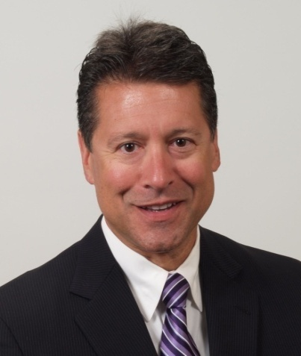
The Panel
Practice limited to eminent domain, condemnation, redevelopment and real estate tax appeals
30+ years representing property owners and special counsel to condemning authorities in eminent domain matters
New Jersey “Super Lawyer” (“Top 100” - 2009-2017; “Top 10” – 2012)
Anthony F. Della Pelle, Esq., CRE ‘84
adellapelle@mckirdyriskin.com
www.mckirdyriskin.com
Shareholder: McKirdy, Riskin, Olson & DellaPelle, PC
Certified Civil Trial Attorney by N.J. Supreme Court
New Jersey Representative, Owners’ Counsel of America
Member, Counselors of Real Estate®

Slide 3

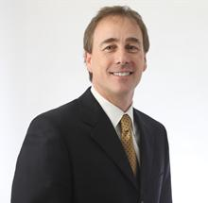
The Panel
Mark E. Duckstein, Esq. ‘84
mduckstein@sillscummis.com
www.sillscummis.com
Practice concentrated on the representation of corporations and other business enterprises in complex litigation involving real estate, commercial torts and contract disputes.
Extensive experience representing commercial and retail landlords, insurance companies, major lending institutions, commercial warehousing companies, and hospitals and health care providers.
The Best Lawyers in America®* 2013-2018, Commercial Litigation
Partner: Sills, Cummis & Gross, P.C.

Slide 4
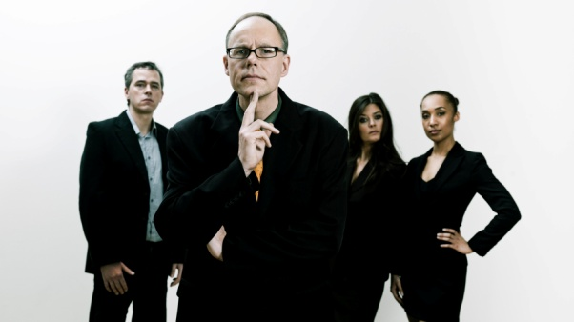
CROSS EXAMINATION BASICS
  Purpose and Objectives
    Discredit
    Obtain concessions/admissions
    Demonstrate bias, lack of candor, partisanship, etc.
    Reveal other traits, such as reputation, appearance, competence, lack of cooperation
  Preparation
    Develop and understand theme of the case
    Gather background
      Internet research
      Industry research – informal/formal – published articles can be a treasure trove!
      Prior inconsistent statements
      Research regarding all material cited and relied upon in report
      Review other discovery – interrogatories, document production, requests for admissions, etc.

Slide 5
CROSS EXAMINATION BASICS (cont’d)
  C. Careful Analysis of Report(s)
    Become an expert in the field
    Use other experts to assist
    Check and verify each fact
  D. Forum – consider the forum and tailor cross appropriately
    Deposition
    Jury/bench trial
    Arbitration Panel
    Condemnation Commissioners
    Zoning/Planning Boards
    Other forums

Slide 6
II. DISCOVERY, PRIVILEGE AND PRACTICAL CONSIDERATIONS WITH EXPERTS
  Understand the rules regarding experts and discovery
    Consider attorney/client privilege vs. attorney work product protections
    B. Given the evolving case law in this area, great care must be given to what an attorney decides to physically provide and orally state to the testifying expert.
    Drafts
    Communications between expert and client.

Slide 7
III. PRIOR REPORTS/INCONSISTENT STATEMENTS
Prior inconsistent statements – sworn statements and testimony; documents; other statements
Prior reports prepared by the expert who testifies are admissible for use or impeachment.
  Review for missing or inaccurate information
  Expert loses credibility
  “False in one, false in all” jury charge
Must draft reports be produced for use on cross-examination?
  It doesn’t matter what label has been put on the prior report, “draft”, “attorney’s work product”, “confidential”, etc.
  If prepared by the witness, it qualifies as a prior report.

Slide 8
IV. PREPARING WITNESSES FOR TESTIMONY
Witness demeanor and appearance
Deposition testimony
Trial/hearing testimony
  Direct examination
  Cross examination – cooperative or combative?
    Volunteering information?
  Examination by judge, arbitrators or public
  Play to the audience
  KISS and other tips
Rebuttal testimony
Witness sequestration/active consultation while in court/hearing
Preparation and use of trial exhibits – electronic vs. paper

Slide 9
V. PRINCIPLES OF CROSS EXAMINATION
Be brief?
Know the answer to every question asked
Control the witness
Limit answers to yes or no
Make sure the trier of fact understands and pays attention
Never ask why
Never let the witness explain
Lead the witness down the forbidden path – play to his/her strength (weakness)
Gain concessions?
Go for the jugular

Slide 10
VI. CONCLUSION
Have a simple strategy
Prepare, prepare, prepare
Don’t telegraph the strategy in discovery
Be able to support your facts with documents or other testimony
Take your time. Build a foundation and climb the mountain
Be professional and polite
Know the answer to the questions
Don’t waste time, energy or words – constantly score
Stop when you are ahead
Be brief. Or not!

