Slide 1
The Metro New Jersey Chapter of the Appraisal Institute
www.ai-newjersey.org
81st Annual Princeton Conference
April 28, 2017
New Jersey’s Beach Replenishment Program
Peter S. Reinhart, Esq., Moderator
Director, Monmouth University, Kislak Real Estate Institute
David Apy, Assistant Attorney General, State of New Jersey
Anthony F. DellaPelle, Esq., CRE
Donald M. Moliver, Ph.D., MAI, CRE, CTA

Slide 2
Course Outline
Partial Takings Basics
Partial Takings Update: Borough of Harvey Cedars v. Karan, 70 A. 3d 524 (N.J. 2013)
Superstorm Sandy and Storm Protection
Status of Projects and Litigation
Implications for the future

Slide 3
Just Compensation
Compensation for the property taken
Reduction in value (damages) to any remaining property
Interest
Indemnity for loss
Attorneys’ fees (depends upon the jurisdiction)

Slide 4
Entire Taking
Just compensation determined by “fair market value” of the property as of the date of value

Slide 5
Elements of “Fair Market Value” (Just Compensation)
Willing buyer & seller
Neither being under a compulsion to act
Being fully informed of all facts and circumstances about the acquired property (even if not known on date of value)
Three approaches to value – Comparable Sales, Income and Cost
Notes:
State v. Shein, 283 N.J.Super 588 (App. Div. 1995)

Slide 6
Partial Taking - Just compensation determined by two methods
Before and After method value of entire parcel before taking – value of remainder after taking = just compensation
Per Se method value of land taken + diminution in value (or damages) to remainder = just compensation

Slide 7
General Benefits vs. Special Benefits:
General Benefits: those which affect the whole community or neighborhood, and not special benefits unique to the property taken, previously inadmissible in New Jersey
These benefits are/were thought to have been enjoyed by entire area
Why should the condemnee pay more for a public improvement than his/her neighbor whose property is not taken?
Special Benefits: Unique to the property taken, are admissible
Consistent with the Project Influence Doctrine

Slide 8
General Benefits vs. Special Benefits: Harvey Cedars v. Karan
$2+M oceanfront home on Long Beach Island – 18 mile long barrier island
Borough condemns a “dune easement” to allow US Army Corps of Engineers to construct a 22-foot high dune on the property
Borough offers $300 for easement; contends damages are “de minimus”
Owner’s appraiser: loss of views cause $500,000 of damages
Owner moves in limine to bar Borough appraisal which contends that taking creates “special benefits” via storm protection provided by dune
Evidence excluded by trial court as “general benefit”
Jury awards $375,000 in damages
Trial court ruling affirmed by Appellate Division

Slide 9
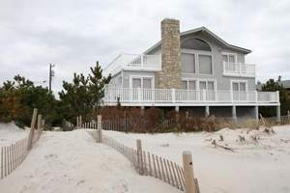
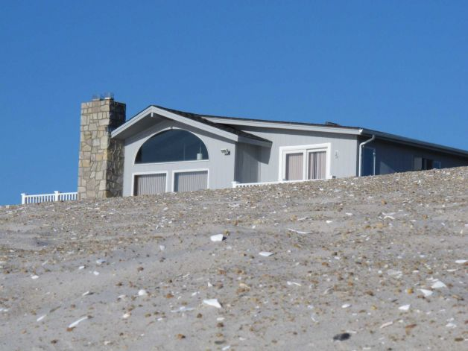
Harvey Cedars v. Karan: Before and After
Before After

Slide 10
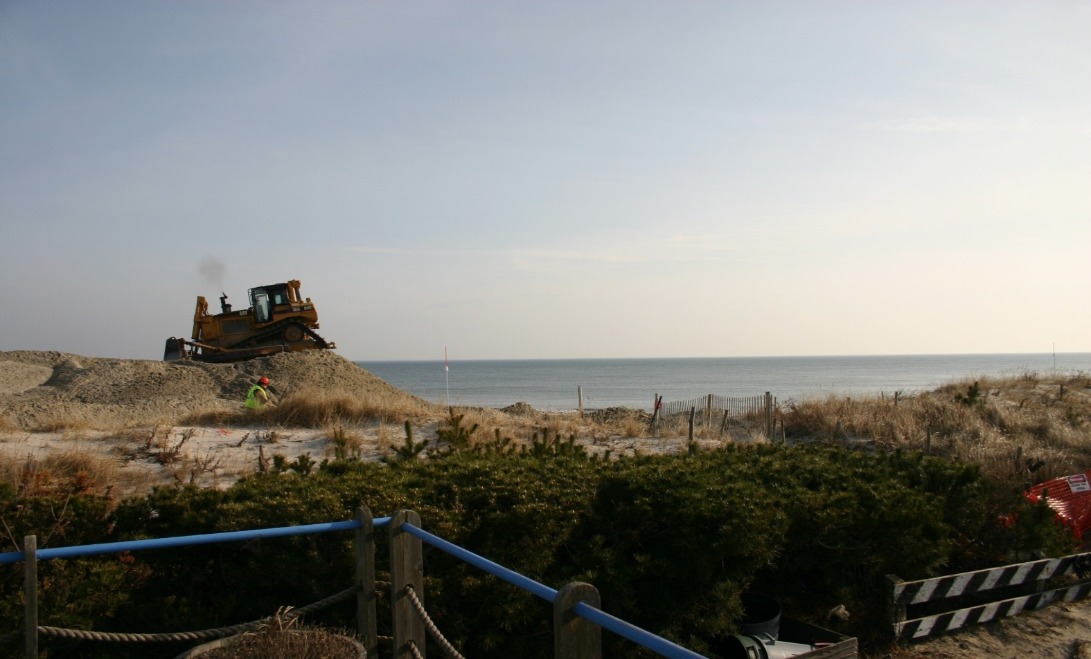
Harvey Cedars v. Karan: Before and After

Slide 11
Dune Replenishment and Partial Takings
Harvey Cedars v. Karan – the setting:
Supreme Court grants certification before Superstorm Sandy
Superstorm Sandy causes catastrophic property losses
Areas with engineered dunes “fare much better” than those without
Dune/storm replenishment efforts are renewed in earnest along the Shore
Public perception and media portrayal paints “holdout” oceanfront property owners as greedy, selfish, obstructionists
Amicus curiae status granted to State of New Jersey and other interest groups
Arguments held May, 2013

Slide 12
Dune Replenishment and Partial Takings
Harvey Cedars v. Karan – the decision (July, 2013):
general-benefits doctrine is “at odds with contemporary principles of just-compensation jurisprudence”
Jury only permitted to hear “one side” of the story
Could result in a “windfall” to the property owners at public expense
Just compensation in partial taking must be based upon a consideration of “all relevant, reasonably calculable, and non-conjectural factors that either decrease or increase the value of the remaining property”
Court recognizes that the loss of view is compensable, but requires rehearing permitting evidence regarding the impact of the storm protection benefits upon the value of the property as an offset to damages

Slide 13
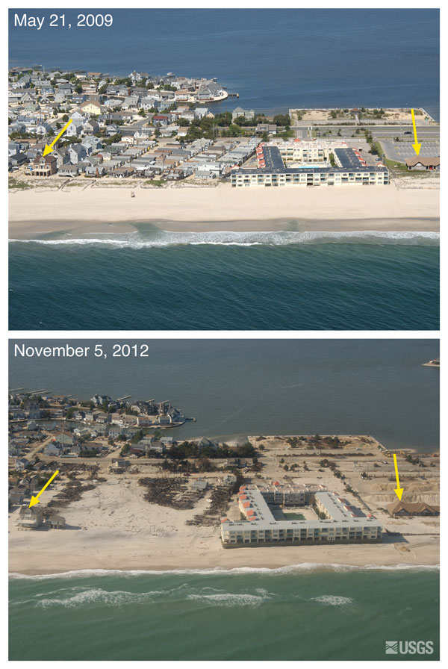
Dune Replenishment and Partial Takings – Before and After the Storm

Slide 14
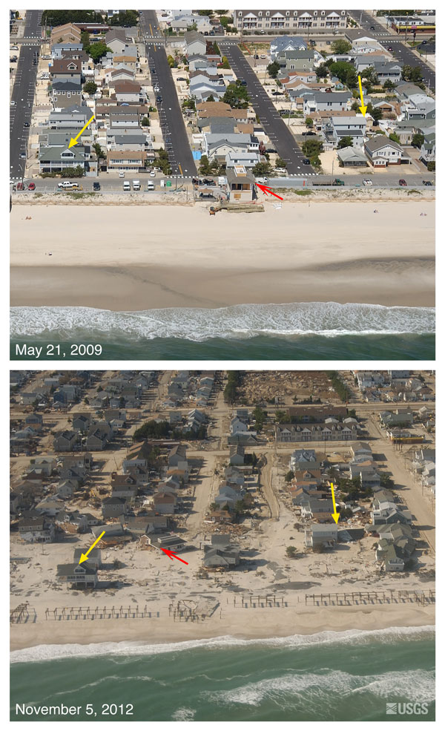
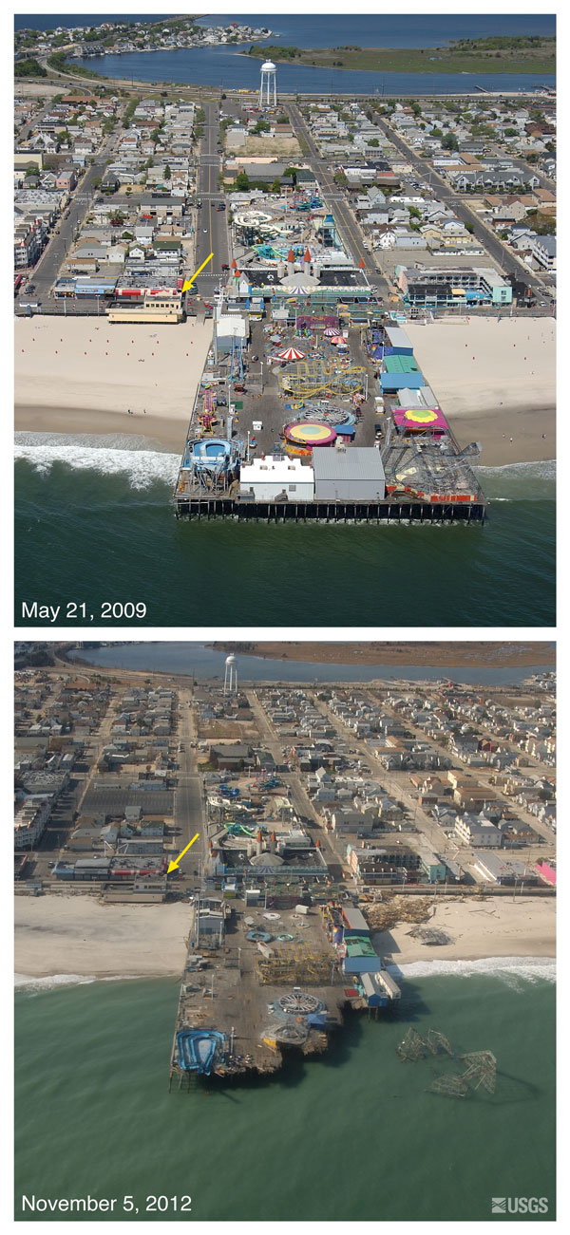
Dune Replenishment and Partial Takings – Before and After the Storm

Slide 15
Manasquan Inlet to Barnegat Inlet Beachfill Project Casino Pier, Seaside Heights
Aerial Imagery April 2016 with Digital Overlay of Proposed Project Lines

Slide 16
Ocean Beach III Toms River (North Section)
Aerial Imagery April 2015 with Digital Overlay of Proposed Project Lines

Slide 17
Ocean Beach III Toms River (North Section)
Aerial Imagery April 2015

Slide 18
Army Corps Project Plan Cross Section, Toms River (North Section)

Slide 19
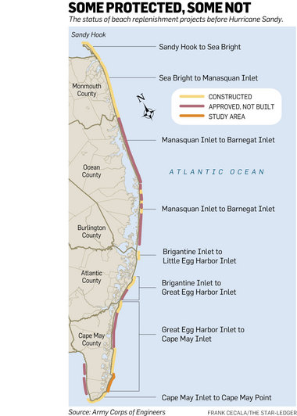
Dune Replenishment and Partial Takings – the Project

Slide 20
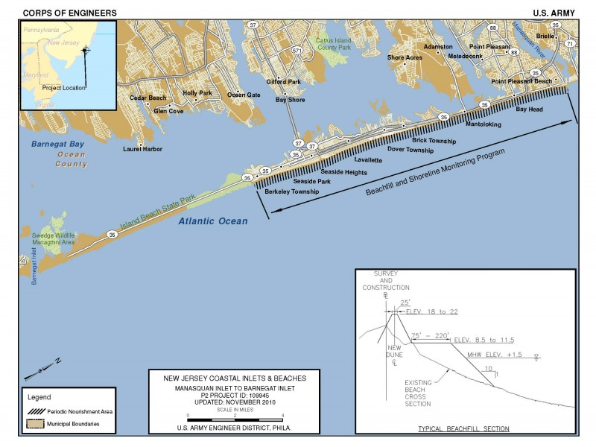
Dune Replenishment and Partial Takings – the Project

Slide 21
Dune Replenishment and Partial Takings
Harvey Cedars v. Karan – the implications:
Did Karan cause the “holdouts” to change course and donate their properties?
Mr. and Mrs. Karan settle for $1 – WHY?
What impacts will or may it have on just compensation determinations, from the condemnor’s offers to the commissioners’ awards and jury awards that result?
Harvey Cedars v. Groisser
Does the decision provide guidance on whether the “benefits” can be offset against the value of the part taken, or against severance damages only?
What remains of the “project influence” doctrine? Shield or sword?
Related issues: loss of access, ambiguity in description of rights obtained and scope of rights retained

Slide 22
The Storm Replenishment Project – 4 Years Later
Continued vilification of “holdouts” – approximately 300 (10%) remained
USACOE to build under Project Partnership Agreements
State (NJDEP) control over project as “Non-Federal Sponsor”
Municipal role
“Emergency” measures under Disaster Control Act taken
Declaratory judgment actions instituted
Condemnations begin
Update on status of construction

Slide 23
The Storm Replenishment Project – 4 Years Later
STATUS OF LITIGATION
Filed condemnations in Ocean County and Atlantic County
Appointment of Commissioners in uncontested takings
Contested takings
Margate litigation
Right to condemn challenged on various grounds in Ocean County matters
Consolidated appeals pending, to be argued 5/2/17
Bay Head litigation
Issues presented on right to condemn”
Does proper legislative authorization exist?
Easements vs. Fee Simple Interests
Conversion of Private Beaches to Public Beaches
“Bona Fide” Negotiations
Arbitrariness/necessity
Other procedural issues

Slide 24
Final Thoughts
Q&A?
Thank you!

