Slide 1
Natural Disasters and the Law: The Aftermath of Superstorm Sandy and its Impact Upon Property Rights in New Jersey
Anthony F. DellaPelle, Esq, CRE®
May 12, 2016

Slide 2
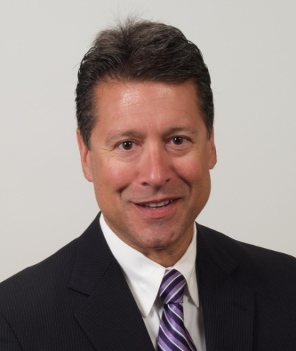
Anthony F. Della Pelle, Esq. , CRE®
adellapelle@mckirdyriskin.com
www.mckirdyriskin.com
Practice limited to eminent domain, condemnation, redevelopment and real estate tax appeals
25+ years representing property owners and special counsel to condemning authorities in eminent domain matters
Author, New Jersey Condemnation Law Blog, www.njcondemnationlaw.com
Subcommittee Chair, ABA Section of Litigation – Condemnation, Land Use & Zoning Committee
Member of Governor Chris Christie’s Transition Team – Authorities Committee (2009)
Shareholder, McKirdy & Riskin, PA , Morristown, New Jersey
Certified Civil Trial Attorney by NJ Supreme Court
New Jersey Representative, Owners’ Counsel of America
Member, Counselors of Real Estate®

Slide 3
Course Outline
Partial Takings Basics
Partial Takings Update: Borough of Harvey Cedars v. Karan, 70 A. 3d 524 (N.J. 2013)
Superstorm Sandy and Storm Protection
Implications for the future

Slide 4
Just Compensation
Compensation for the property taken
Reduction in value (damages) to any remaining property
Interest
Indemnity for loss
Attorneys’ fees (depends upon the jurisdiction)

Slide 5
Entire Taking
Just compensation determined by “fair market value” of the property as of the date of value

Slide 6
Elements of “Fair Market Value” (Just Compensation)
Willing buyer & seller
Neither being under a compulsion to act
Being fully informed of all facts and circumstances about the acquired property (even if not known on date of value)
Three approaches to value – Comparable Sales, Income and Cost
Notes:
State v. Shein, 283 N.J.Super 588 (App. Div. 1995)

Slide 7
Partial Taking - Just compensation determined by two methods
Before and After method value of entire parcel before taking – value of remainder after taking = just compensation
Per Se method value of land taken + diminution in value (or damages) to remainder = just compensation

Slide 8
The Project Influence Doctrine
Ordinarily, the effect upon value of a proposed project – either up or down - must be disregarded in valuation
Highest and best use issues - zoning
Physical condition of subject
Selection of sales or leases
Adjustments to sales or leases
The property is valued as if the “project” never occurred.
Notes:
Idea is to obtain value free from influences on value resulting from “the Project”
Value might rise or fall
What is “the Project” – AC example, Hyman example
Does the taking need to be a “redevelopment” taking to trigger project influence of redevelopment plan?
Does project make it more difficult to find “true”, unaffected market

Slide 9
General Benefits vs. Special Benefits:
General Benefits: those which affect the whole community or neighborhood, and not special benefits unique to the property taken, previously inadmissible in New Jersey
These benefits are/were thought to have been enjoyed by entire area
Why should the condemnee pay more for a public improvement than his/her neighbor whose property is not taken?
Special Benefits: Unique to the property taken, are admissible
Consistent with the Project Influence Doctrine

Slide 10
General Benefits vs. Special Benefits: Harvey Cedars v. Karan
$2+M oceanfront home on Long Beach Island – 18 mile long barrier island
Borough condemns a “dune easement” to allow US Army Corps of Engineers to construct a 22-foot high dune on the property
Borough offers $300 for easement; contends damages are “de minimus”
Owner’s appraiser: loss of views cause $500,000 of damages
Owner moves in limine to bar Borough appraisal which contends that taking creates “special benefits” via storm protection provided by dune
Evidence excluded by trial court as “general benefit”
Jury awards $375,000 in damages
Trial court ruling affirmed by Appellate Division

Slide 11
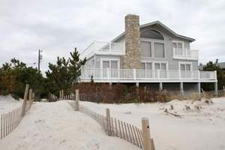
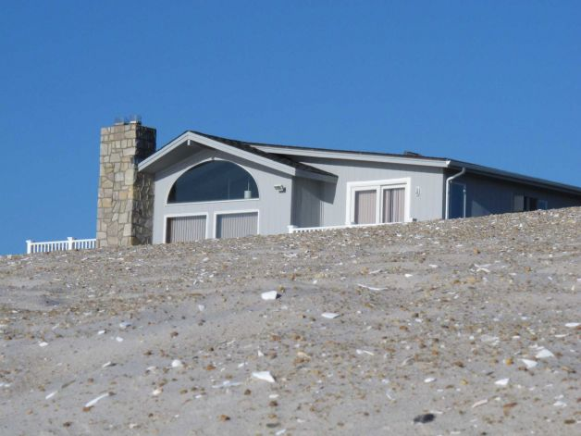
Harvey Cedars v. Karan: Before and After
Before After

Slide 12
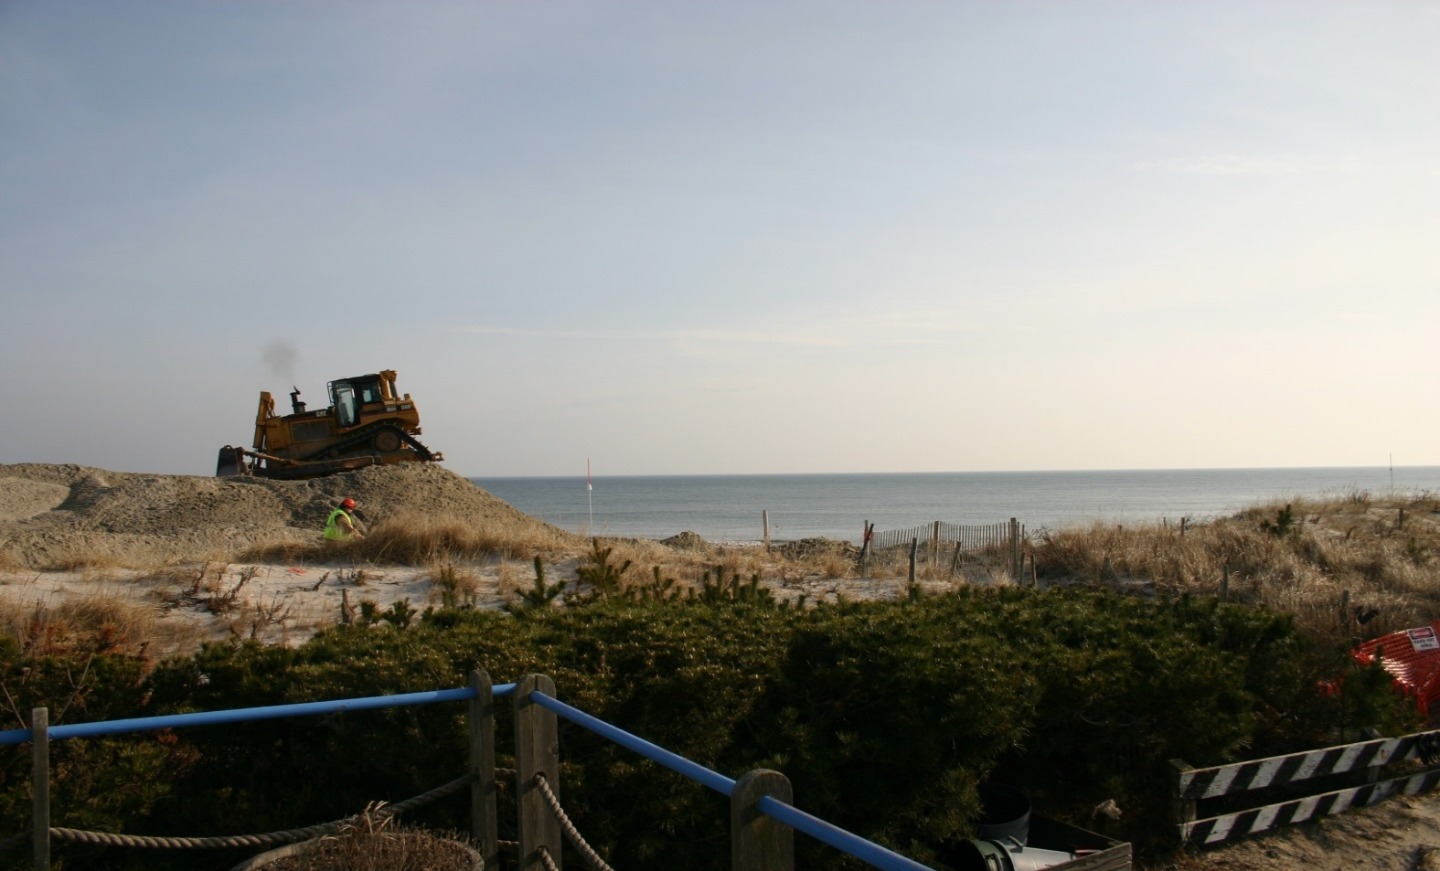
Harvey Cedars v. Karan: Before and After

Slide 13
Dune Replenishment and Partial Takings
Harvey Cedars v. Karan – the setting:
Supreme Court grants certification before Superstorm Sandy
Superstorm Sandy causes catastrophic property losses
Areas with engineered dunes fare much better than those without
Dune/storm replenishment efforts are renewed in earnest along the Shore
Public perception and media portrayal paints “holdout” oceanfront property owners as greedy, selfish, obstructionists
Increasing political pressure mounted at local and State levels, subjecting owners to ridicule and shame
Amicus curiae status granted to State of New Jersey and other interest groups
Arguments held May, 2013

Slide 14
Dune Replenishment and Partial Takings
Harvey Cedars v. Karan – the decision (July, 2013):
general-benefits doctrine is “at odds with contemporary principles of just-compensation jurisprudence”
Jury only permitted to hear “one side” of the story
Could result in a “windfall” to the property owners at public expense
Just compensation in partial taking must be based upon a consideration of “all relevant, reasonably calculable, and non-conjectural factors that either decrease or increase the value of the remaining property”
Court recognizes that the loss of view is compensable, but requires rehearing permitting evidence regarding the impact of the storm protection benefits upon the value of the property as an offset to damages

Slide 15
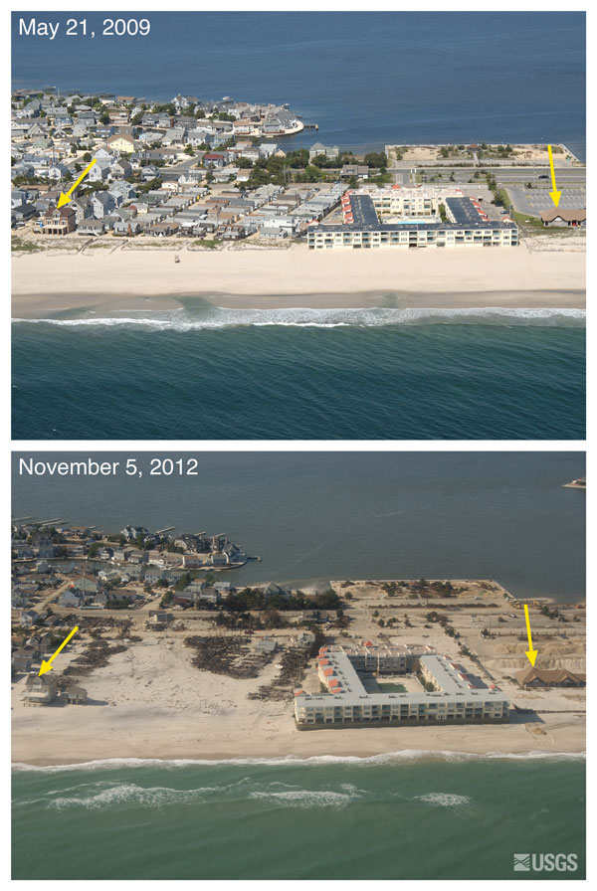
Dune Replenishment and Partial Takings – Before and After the Storm

Slide 16
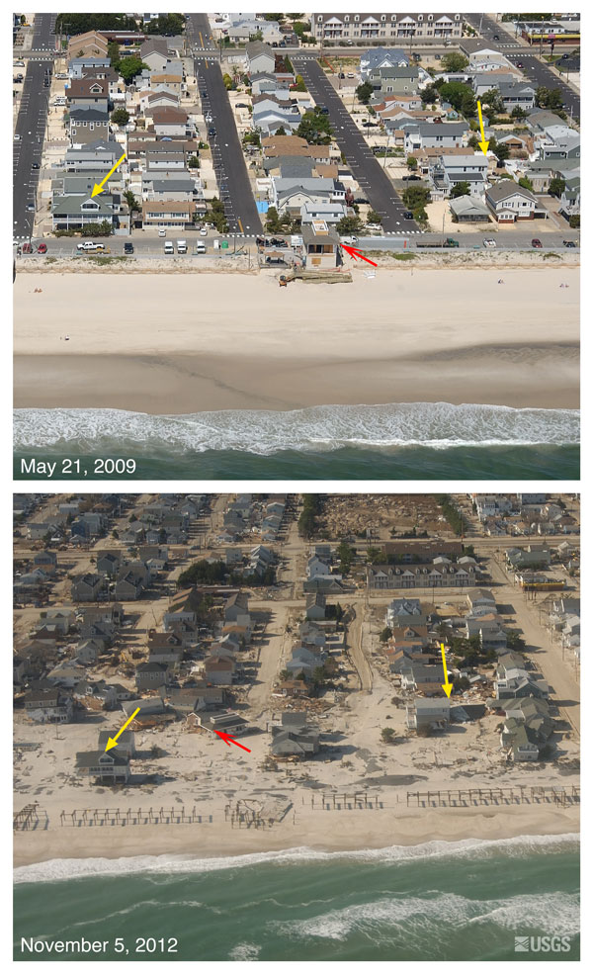
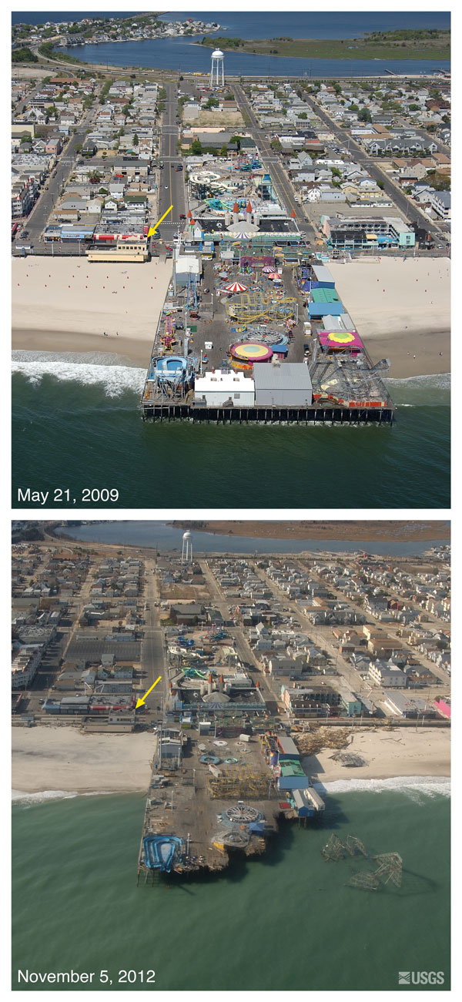
Dune Replenishment and Partial Takings – Before and After the Storm

Slide 17
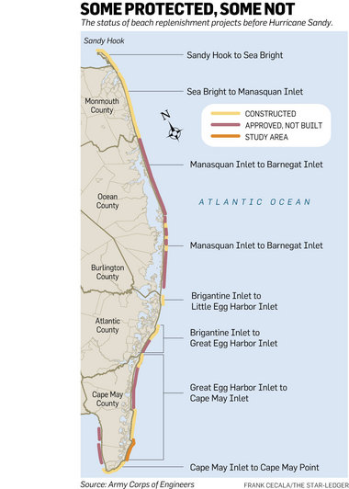
Dune Replenishment and Partial Takings – the Project

Slide 18
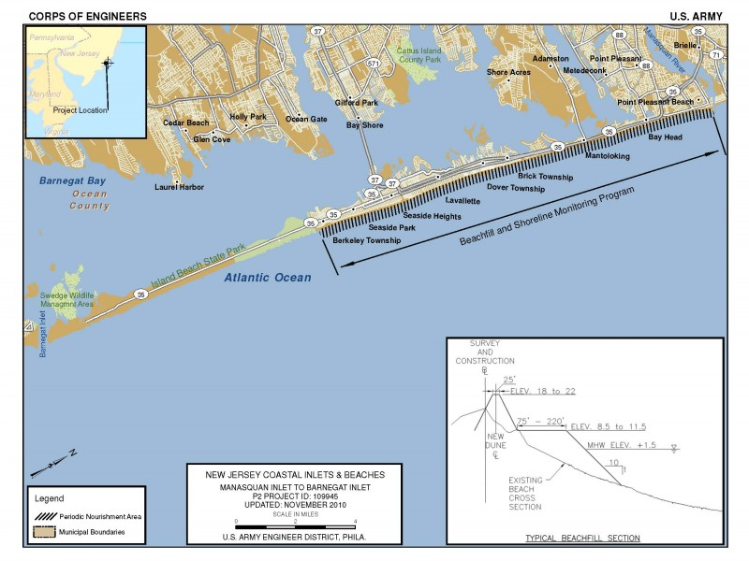
Dune Replenishment and Partial Takings – the Project

Slide 19
Dune Replenishment and Partial Takings
Harvey Cedars v. Karan – the implications:
Did Karan cause the “holdouts” to change course and donate their properties?
Mr. and Mrs. Karan settle for $1 – WHY?
What impacts will or may it have on just compensation determinations, from the condemnor’s offers to the commissioners’ awards and jury awards that result?
Harvey Cedars v. Groisser
Does the decision provide guidance on whether the “benefits” can be offset against the value of the part taken, or against severance damages only?
What remains of the “project influence” doctrine? Shield or sword?
Related issues: loss of access, loss of private beach under public trust doctrine, ambiguity in description of rights obtained
Funding implications and realities

Slide 20
The Storm Replenishment Project – 3 Years Later, and Counting
Continued vilification of “holdouts” – approximately 300 (10%) remain
USACOE to build under Project Partnership Agreements
State (NJDEP) control over project as “Non-Federal Sponsor”
Municipal role
“Emergency” measures under Disaster Control Act taken
Declaratory judgment actions instituted
Condemnations begin
Issues presented on right to condemn”
Does proper legislative authorization exist?
Easements vs. Fee Simple Interests
Conversion of Private Beaches to Public Beaches
“Bona Fide” Negotiations
Other procedural issues
The latest from the pending cases

Slide 21
Final Thoughts
Q&A?
Thank you!
Anthony F. DellaPelle, Esq., CRE®
adellapelle@mckirdyriskin.com
www.mckirdyriskin.com
www.njcondemnationlaw.com
www.realestatetaxappeals.com

